Slide 1


CMR TECHNICAL CAMPUS
UGC AUTONOMOUS
Accredited by NBA & NAAC with A Grade
Approved by AICTE, New Delhi and Affiliated to JNTU, Hyderabad
Department of Information Technology
Review-2
Major Project
on
NLP-based Analysis of Cyber Threats and Vulnerabilities of
The Healthcare Ecosystem
Under the Guidance of
G.Divya
Assistant Professor
Presented By:
D.Sruthi (227R1A1281)
Md.Samiuddin (237R5A1207)
P.Nitheesh (227R1A12C1)

Slide 2
AGENDA
Introduction
Modules
Conclusion
Proposed System
Advantages
System Architecture

Slide 3
INTRODUCTION
Cybersecurity has become one of the most pressing challenges in the healthcare ecosystem, with real-world statistics showing an alarming surge in incidents.
• Data is a key asset in this unified information society, and its usage should be under the owner's control.
• In 2023 alone, over 133 million individuals were impacted by healthcare data breaches in United States, nearly doubling the previous year’s figures.
• These incidents not only compromise sensitive patient data but also directly affect patient safety, as delays or system outages can hinder treatment, The rise in Internet-of-Medical-Things (IoMT) devices, telemedicine platforms, and electronic health records has further expanded the attack surface,
• Given this landscape, the healthcare sector urgently requires intelligent, automated, and proactive mechanisms to analyze threats and strengthen its resilience.
.

Slide 4
PROPOSED SYSTEM
• Machine Learning: The proposed system integrates NLP with machine learning models and algorithms (DEBERT) to automate the analysis of cyber threats in healthcare..
• AI: A secure computing platform that generates intelligent security rules. It checks if the user has permission to access shared data, detects vulnerabilities unique to healthcare systems.
• NLP Preprocessing: First, textual incident descriptions are preprocessed using tokenization, stopword removal, and lemmatization, ensuring standardized input data, next EDA techniques, such as word frequency and part-of-speech analysis, provide insights into the linguistic structure of threats.

Slide 5
ADVANTAGES OF PROPOSED SYSTEM
Provides more data security compared to previous system.
Enhances patient safety and trust by ensuring continuous protection of sensitive healthcare data and systems.
Handles large data efficiently, understands threat context better.

Slide 6
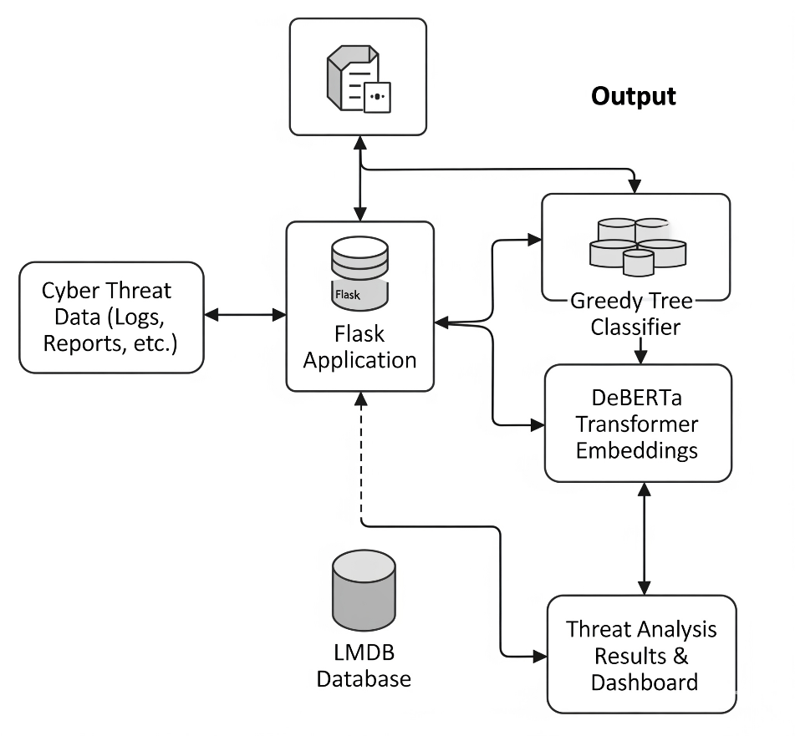
SYSTEM ARCHITECTURE

Slide 7
MODULES
• Data Acquisition Module: Gathers cybersecurity - related text data from diverse sources such as a threat intelligence feeds (CVE, NVD), healthcare incident reports, research articles, and online forums. This module ensures the system has comprehensive and up-to-date threat information for analysis.
• Data Pre-processing Module: Cleans and prepares the collected text by removing noise, duplicates, and irrelevant content. It performs tokenization, stopword removal, and lemmatization to standardize the text and make it suitable for NLP processing.
• NLP Feature Extraction Module: Converts pre processed text into numerical form using an techniques like TF-IDF, Word2Vec, or BERT embeddings. This enables the system to understand and process textual data for machine learning and deep learning models.

Slide 8
MODULES
• Threat Classification and Vulnerability Mapping Module: Classifies extracted information into categories (e.g., ransomware, phishing, DDoS) and maps identified threats to known vulnerabilities (e.g., CVEs). This helps in understanding which healthcare assets or systems are at risk.
• Threat Analysis and Visualization Module: Analyzes patterns, trends, and severity levels of detected threats over time. It visualizes insights through dashboards and charts, helping cybersecurity professionals monitor emerging threats and make informed decisions.

Slide 9
CONCLUSION
This project demonstrates how advanced NLP and machine learning techniques can enhance cybersecurity in the healthcare ecosystem. By automating the analysis of cyber threats and vulnerabilities, the system enables faster, more accurate detection and response. It helps protect sensitive patient data and critical medical infrastructure from evolving cyber risks. Overall, this approach strengthens healthcare security while ensuring compliance with privacy regulations.

Slide 10


